Slide 1

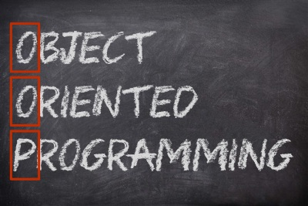

Наследяване
Йерархии от класове
ООП
Учителски екип
Обучение за ИТ кариера
https://it-kariera.mon.bg/e-learning/

Slide 2

Съдържание
Наследяване
Йерархии от класове
Наследяване в C#
Достъп до членове на базовия клас
Повторно използване на класове

Slide 3
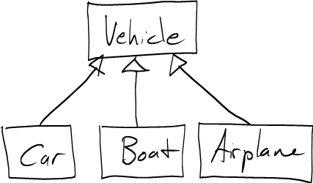
Наследяване
Начин за разширяване на класовете и повторно използване на кода
3

Slide 4
Наследяване – пример
Базов клас
Суперклас
Person
Родителски клас
+Name: string
+Address: string
Производен клас
Производен клас
Подклас
Подклас
Employee
Student
+Company: string
+School: string
Дъщеренклас
Дъщеренклас

Slide 5
Йерархия от класове
Наследяването води до йерархии от класове и/или интерфейси в приложението:
Базовите класове съдържат общите характеристики
Game
SinglePlayerGame
MultiplePlayersGame
Minesweeper
Solitaire
BoardGame
…
…
Chess
Backgammon

Slide 6
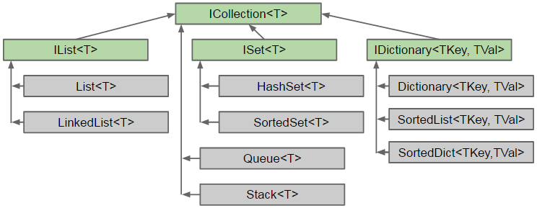
Йерархия от класове – C# Collection

Slide 7
Наследяване в C#
В C# наследяването се отбелязва чрез : оператора
class Person { … }
class Student : Person { … }
class Employee : Person { … }
Person
Student : Person
Student
Employee
Notes:
Extensibility / Polymorphism: New functionality may be easily plugged in without changing existing classes as long the new plug-in classes extend given base classes.
Reusability: For a set of similar applications a framework can be defined using a core set of classes that are to be extended by classes that fill in the application-dependent part.
Information Hiding: If a more general class using a simpler contract is sufficient, details from extending classes may be hidden to some of the client classes. This allows them to be more independent from possible changes and diminishes the load of contracts that must be understood by a reader of these client classes.
(c) 2006 National Academy for Software Development - http://academy.devbg.org*
7##

Slide 8
Наследяване – дъщерен клас
Класът получава всички членове от родителския си клас
Person
Повторно използване на класа Person
Разширяване на класа Person
Mother : Person
Father : Person
Student
Employee
School: School
Org: Organization

Slide 9
Използване на наследени членове
Наследените членове се използват както обикновено:
class Person { public void Sleep() { … } }
class Student : Person { … }
class Employee : Person { … }
Student student = new Student();
student.Sleep();
Employee employee = new Employee();
employee.Sleep();
Notes:
Extensibility / Polymorphism: New functionality may be easily plugged in without changing existing classes as long the new plug-in classes extend given base classes.
Reusability: For a set of similar applications a framework can be defined using a core set of classes that are to be extended by classes that fill in the application-dependent part.
Information Hiding: If a more general class using a simpler contract is sufficient, details from extending classes may be hidden to some of the client classes. This allows them to be more independent from possible changes and diminishes the load of contracts that must be understood by a reader of these client classes.
(c) 2006 National Academy for Software Development - http://academy.devbg.org*
9##

Slide 10
Преизползване на конструктори
Конструкторите не се наследяват
Конструкторите може да се ползват от дъщерните класове
class Student : Person {
private School school;
public Student(String name, School school)
:base(name)
{
this.school = school;
}
}
Notes:
Extensibility / Polymorphism: New functionality may be easily plugged in without changing existing classes as long the new plug-in classes extend given base classes.
Reusability: For a set of similar applications a framework can be defined using a core set of classes that are to be extended by classes that fill in the application-dependent part.
Information Hiding: If a more general class using a simpler contract is sufficient, details from extending classes may be hidden to some of the client classes. This allows them to be more independent from possible changes and diminishes the load of contracts that must be understood by a reader of these client classes.
(c) 2006 National Academy for Software Development - http://academy.devbg.org*
10##

Slide 11
Наследяване и модификатори за достъп
Подкласовете могат да достъпят всички public и protected членове, както и могат да достъпят internal членовете, ако са в същия проект
Private полетата не се наследяват в подкласовете
class Person {
private string id;
string name;
protected string address;
public void Sleep();
}
Може да се достъпи чрез другите методи на класа Person
Notes:
Extensibility / Polymorphism: New functionality may be easily plugged in without changing existing classes as long the new plug-in classes extend given base classes.
Reusability: For a set of similar applications a framework can be defined using a core set of classes that are to be extended by classes that fill in the application-dependent part.
Information Hiding: If a more general class using a simpler contract is sufficient, details from extending classes may be hidden to some of the client classes. This allows them to be more independent from possible changes and diminishes the load of contracts that must be understood by a reader of these client classes.
(c) 2006 National Academy for Software Development - http://academy.devbg.org*
11##

Slide 12
„Засенчване“ на променливи
Подкласовете могат да скрият променливи от суперкласа
class Person { protected int weight; }
class Patient : Person
{
protected float weight;
public void Method()
{
double weight = 0.5d;
}
}
Скрива int weight
Скрива и двете
Notes:
Extensibility / Polymorphism: New functionality may be easily plugged in without changing existing classes as long the new plug-in classes extend given base classes.
Reusability: For a set of similar applications a framework can be defined using a core set of classes that are to be extended by classes that fill in the application-dependent part.
Information Hiding: If a more general class using a simpler contract is sufficient, details from extending classes may be hidden to some of the client classes. This allows them to be more independent from possible changes and diminishes the load of contracts that must be understood by a reader of these client classes.
(c) 2006 National Academy for Software Development - http://academy.devbg.org*
12##

Slide 13
Достъп до членове на базовия клас
Чрез ключовата дума basе
class Person { … }
class Employee : Person
{
void Fire(string reasons) {
Console.Writeline
($"{base.name} got fired because {reasons}");
}
}
Notes:
Extensibility / Polymorphism: New functionality may be easily plugged in without changing existing classes as long the new plug-in classes extend given base classes.
Reusability: For a set of similar applications a framework can be defined using a core set of classes that are to be extended by classes that fill in the application-dependent part.
Information Hiding: If a more general class using a simpler contract is sufficient, details from extending classes may be hidden to some of the client classes. This allows them to be more independent from possible changes and diminishes the load of contracts that must be understood by a reader of these client classes.
(c) 2006 National Academy for Software Development - http://academy.devbg.org*
13##

Slide 14
„Засенчване“ на променливи – решение
Използвайте base и this, за да уточните достъпа
class Patient : Person
{
protected float weight;
public void Method()
{
double weight = 0.5d;
this.weight = 0.6f;
base.weight = 1;
}
}
Локална променлива
Член на инстанцията
Член на базовия клас
Notes:
Extensibility / Polymorphism: New functionality may be easily plugged in without changing existing classes as long the new plug-in classes extend given base classes.
Reusability: For a set of similar applications a framework can be defined using a core set of classes that are to be extended by classes that fill in the application-dependent part.
Information Hiding: If a more general class using a simpler contract is sufficient, details from extending classes may be hidden to some of the client classes. This allows them to be more independent from possible changes and diminishes the load of contracts that must be understood by a reader of these client classes.
(c) 2006 National Academy for Software Development - http://academy.devbg.org*
14##

Slide 15
Наследяването е разширяване
Инстанцията на дъщерен клас съдръжа инстанция на неговия базов клас
Student (Derived Class)
+Study():void
Employee (Derived Class)
+Work():void
Person (Base Class)
+Sleep():void

Slide 16
Наследяване
Наследяването има преходна връзка
class Person { … }
class Student : Person { … }
class CollegeStudent : Student { … }
Person
Student
CollegeStudent
Notes:
Extensibility / Polymorphism: New functionality may be easily plugged in without changing existing classes as long the new plug-in classes extend given base classes.
Reusability: For a set of similar applications a framework can be defined using a core set of classes that are to be extended by classes that fill in the application-dependent part.
Information Hiding: If a more general class using a simpler contract is sufficient, details from extending classes may be hidden to some of the client classes. This allows them to be more independent from possible changes and diminishes the load of contracts that must be understood by a reader of these client classes.
(c) 2006 National Academy for Software Development - http://academy.devbg.org*
16##

Slide 17
Множествено наследяване
В C# не се поддържа множествено наследяване
Поддържа се само имплементиране на множество интерфейси
Person
Student
CollegeStudent
Notes:
Extensibility / Polymorphism: New functionality may be easily plugged in without changing existing classes as long the new plug-in classes extend given base classes.
Reusability: For a set of similar applications a framework can be defined using a core set of classes that are to be extended by classes that fill in the application-dependent part.
Information Hiding: If a more general class using a simpler contract is sufficient, details from extending classes may be hidden to some of the client classes. This allows them to be more independent from possible changes and diminishes the load of contracts that must be understood by a reader of these client classes.
(c) 2006 National Academy for Software Development - http://academy.devbg.org*
17##

Slide 18

Задача: Наследяване
Animal
+Eat():void
Dog
+Bark():void
Notes:
Extensibility / Polymorphism: New functionality may be easily plugged in without changing existing classes as long the new plug-in classes extend given base classes.
Reusability: For a set of similar applications a framework can be defined using a core set of classes that are to be extended by classes that fill in the application-dependent part.
Information Hiding: If a more general class using a simpler contract is sufficient, details from extending classes may be hidden to some of the client classes. This allows them to be more independent from possible changes and diminishes the load of contracts that must be understood by a reader of these client classes.
(c) 2006 National Academy for Software Development - http://academy.devbg.org*
18##

Slide 19
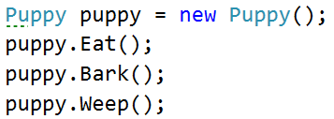
Задача: Наследяване на няколко нива
Animal
+Eat():void
Dog
+Bark():void
Puppy
+Weep():void
Notes:
Extensibility / Polymorphism: New functionality may be easily plugged in without changing existing classes as long the new plug-in classes extend given base classes.
Reusability: For a set of similar applications a framework can be defined using a core set of classes that are to be extended by classes that fill in the application-dependent part.
Information Hiding: If a more general class using a simpler contract is sufficient, details from extending classes may be hidden to some of the client classes. This allows them to be more independent from possible changes and diminishes the load of contracts that must be understood by a reader of these client classes.
(c) 2006 National Academy for Software Development - http://academy.devbg.org*
19##

Slide 20
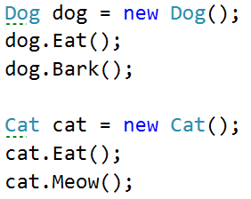
Задача: Йерархично наследяване
Animal
+Eat():void
Dog
Cat
-Bark():void
-Meow():void
Notes:
Extensibility / Polymorphism: New functionality may be easily plugged in without changing existing classes as long the new plug-in classes extend given base classes.
Reusability: For a set of similar applications a framework can be defined using a core set of classes that are to be extended by classes that fill in the application-dependent part.
Information Hiding: If a more general class using a simpler contract is sufficient, details from extending classes may be hidden to some of the client classes. This allows them to be more independent from possible changes and diminishes the load of contracts that must be understood by a reader of these client classes.
(c) 2006 National Academy for Software Development - http://academy.devbg.org*
20##

Slide 21

Видове повторно използване на класове
Разширяване, композиция, делегиране
21

Slide 22
Разширяване
Дублирането на код е податливо на грешки
Преизползване на код чрез разширение
Това е отношение от типа Е: свързаният списък Е списък
Collections
List
LinkedList

Slide 23
Композиция
Използване на класове в дефиницията на друг клас
Това е отношение от типа ИМА: лаптопа ИМА клавиатура
Laptop
class Laptop {
Monitor monitor;
Touchpad touchpad;
Keyboard keyboard;
…
}
Monitor
Touchpad
Преизползване на класове
Keyboard

Slide 24
Делегиране
Делегирането е отношение от типа ИЗВЪРШВА: мониторът ИЗВЪРШВА промяната на яркостта на лаптопа
delegate void Setup();
class Laptop {
private Monitor monitor;
public Setup DecrBrightness;
public Setup IncrBrightness;
public Laptop() {
this.monitor = new Monitor();
this.DecrBrightness = monitor.Dim();
this.IncrBrightness = monitor.Brighten();
}
}
Laptop
increaseBrightness()
decreaseBrightness()
Monitor

Slide 25

Какво научихме днес?
Наследяването е инструмент за повторно използване на код
други начини са композиция и делегиране
Производния клас наследява елементи от базовия клас
те могат да бъдат използвани все едно са негови
Достъпът до елементите на базовия клас е възможен с base

Slide 26
Наследяване
https://it-kariera.mon.bg/e-learning/

Slide 27




Министерство на образованието и науката (МОН)
Настоящият курс (презентации, примери, задачи, упражнения и др.) е разработен за нуждите на Национална програма "Обучение за ИТ кариера" на МОН за подготовка по професия "Приложен програмист"
Курсът е базиран на учебно съдържание и методика, предоставени от фондация "Софтуерен университет" и се разпространява под свободен лиценз CC-BY-NC-SA

